Slide 1
Warehouse robot
Team 6
John ripple, Andrew samson, Michael Klima, josh lee

Slide 2

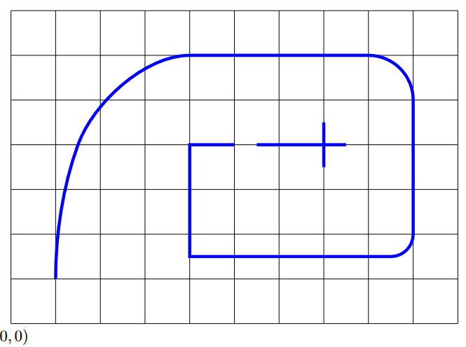

goals
Design a line following robot
Notes:
Warehouse robots need to be able to follow appropriate paths in order to navigate around their workspace. We will design and build a robot that can follow a path defined by 1" wide blue painter’s tape. The robot must be able to keep its rotational center within 1 foot of the tape at all times. The path to be followed will be approximately as given by the image on the slide. The robot’s success will be determined by how far it is able to make it down the path, and the speed at which it travels. Note that there is a break in the tape at (5,4). The robot will have to successfully pass over this break. The robot should stop when it reaches the crossed tape at (7,4)

Slide 3

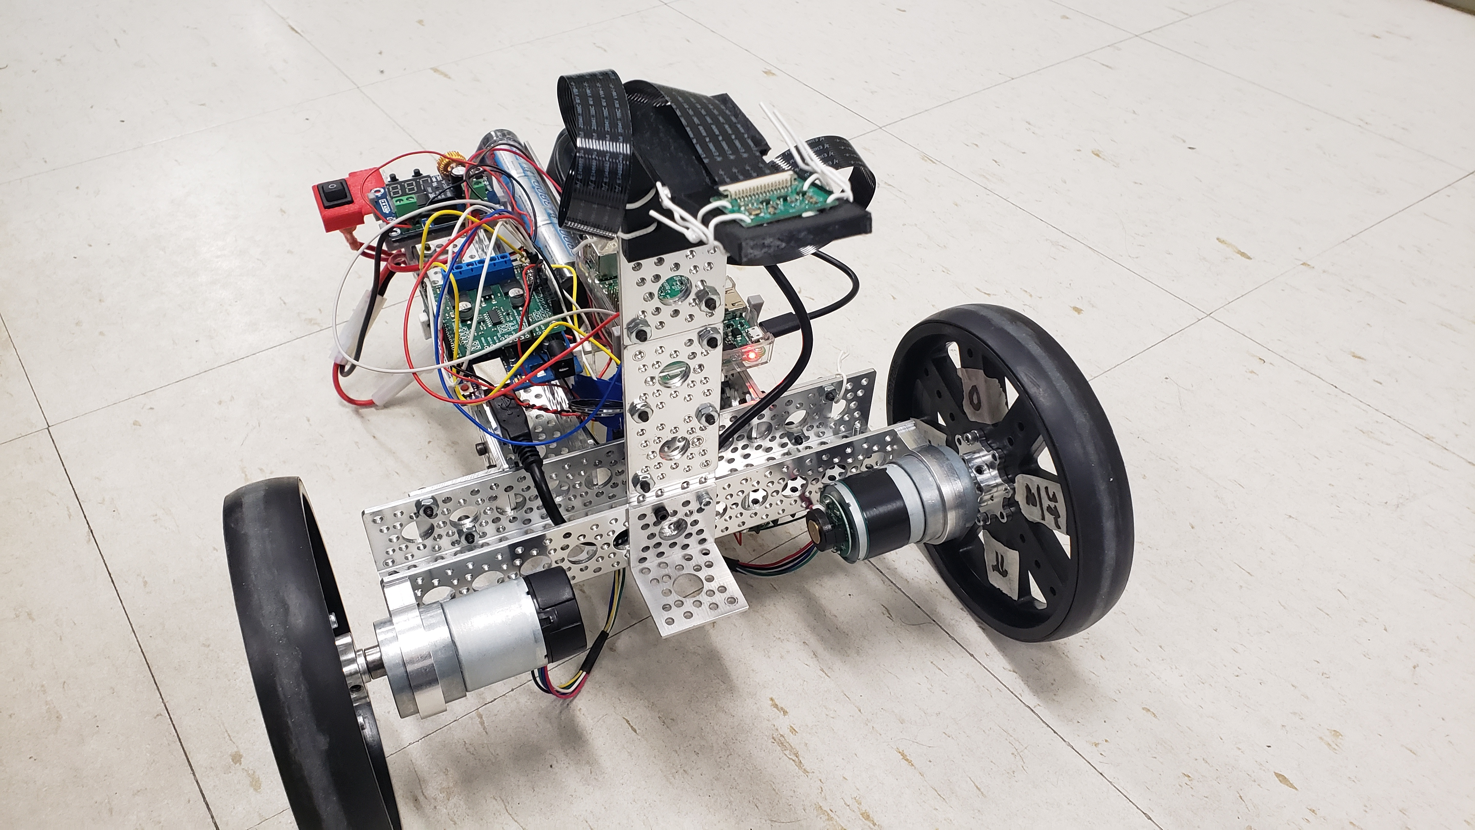
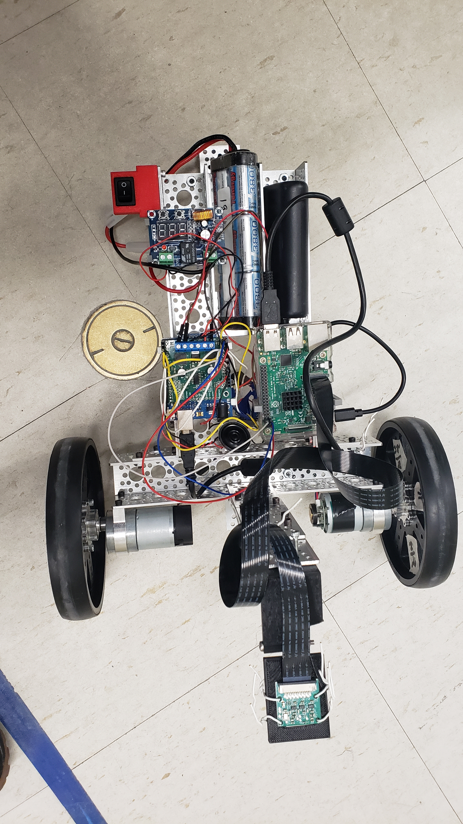
Current design
Motors run on Arduino
Raspberry Pi computer vision
Communication between Arduino and Raspberry Pi

Slide 4
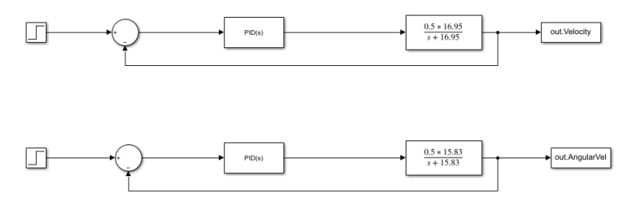
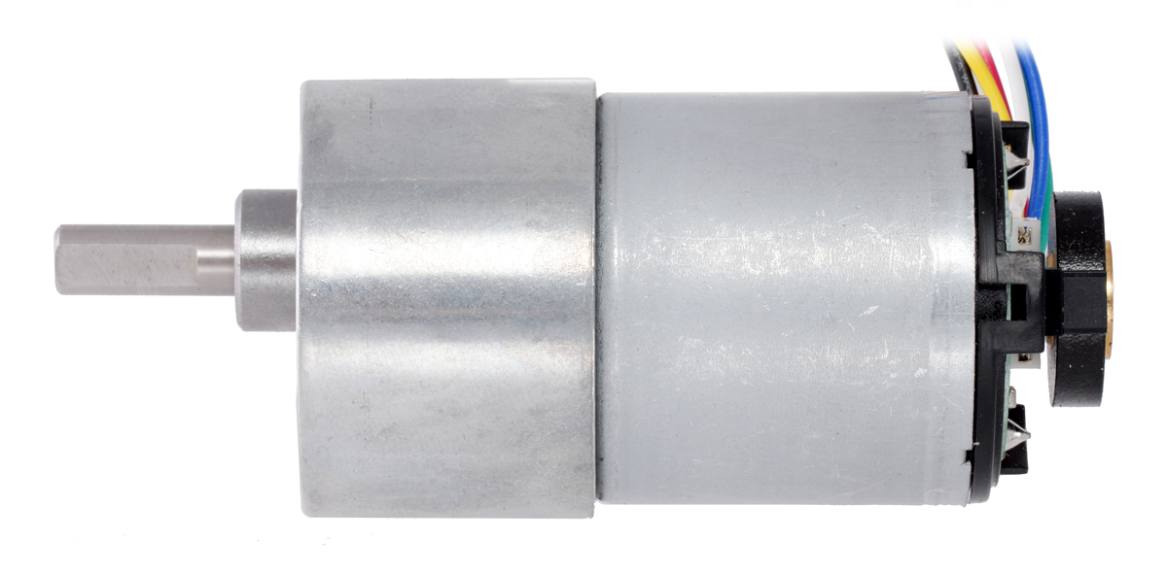
Sim and Control
Simulink for PD controller
PD constants moved to Arduino
Notes:
By setting the motor voltage to high after one second, we were able to run various step response experiments with the motors in order to estimate their transfer functions. These transfer functions were then used in various Simulink simulations to evaluate different controller setups and eventually they were used to tune our controller so that we would have our initial proportional K values. Frankly, most of time was spent with the physical model, tuning it down and making sure it acted as it was coded. These experiments started with us holding the robot, so the wheels were not in contact with anything and printing the values the Arduino was recording to ensure it was following the steps our controllers had set in place. Once we were sure that the robot was following our control structure, we began running the robot by placing it on the ground and observing if it was still properly tracking error now that it had to deal with the weight of the robot. In the end we made an overall P controller which responded to two error values, the horizontal and shift angles which will be discussed later and adjusted two P controllers which controlled the forward error tracking and the angular error tracking. This two controllers added their final values together to set the voltages for the specific wheels with different weight given to the angular and forward error tracking values.

Slide 5
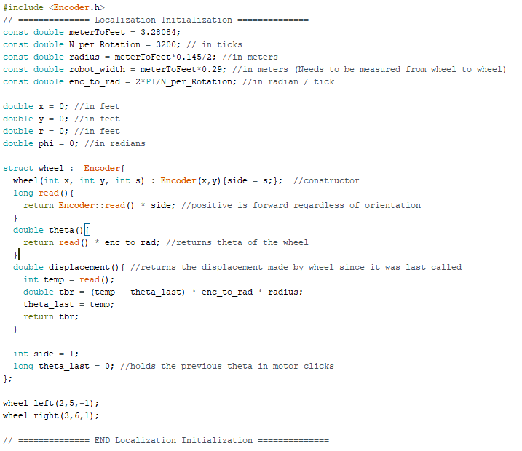
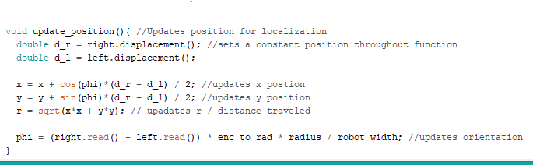
Encoder
Encoder.h
Useful constants
Wheel Setup
Encoder Interpretation
Position
Notes:
We use the Encoder.h library to count the number of ticks made by the encoders in the motors/wheels.
The variables listed are needed or useful for determining the position. (meterToFeet converts a meter measurement to feet. Since we had better precision using metric on the meter stick we measured in metric.) Radius and robot_width are needed to determine how much the bot has actually moved and turned. Enc_to_rad can be used to convert integer encoder readings into a radian value. Then position variables are initialized to 0.
A Wheel structure was made in order to keep code organized. It inherits the properties of the encoder class and adds some functionality to it: orientation interpretation (left side vs right), and variable storage for position interpretation. Two wheel objects are initialized to keep track of the wheels on the robot
Our position updates every iteration of void loop(). It takes the displacement made by the left and right wheels since it was last checked and uses these to calculate x and y. x and y are then used to calculate the total displacement made on the robots journey (r).
The phi is determined based on the wheel readings instead of updating. This is because the orientation can be determined solely off of how much each wheel has moved since the program began and leaves less room for any rounding error from update to update.

Slide 6
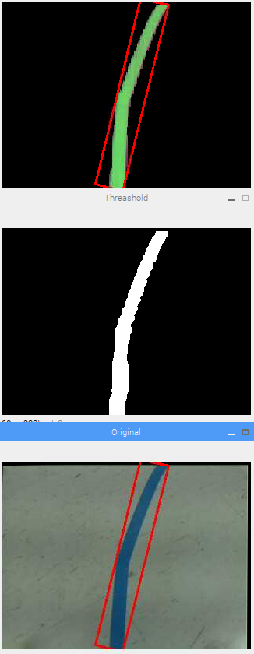
Computer vision
OpenCV
Distortion Correction
Color filtering
Noise Reduction
Contour Selection
Angle detection
Notes:
To make the robot able to interact with the world and get real time feedback we use OpenCV to implement our computer vision. The first step is to start recording video. As the video is recorded each frame has a distortion calibration matrix run on it to remove any fish eye effects the camera might have. After that, a specific color is filtered out of the image (the blue for the tape that is to be followed) and then noise reduction is done. From there the remaining contours of the image are found. The largest contour is assumed to be the tape that needs to be followed and so the angle of that largest contour away from the center of the screen is found to tell the robot what direction to turn and by how much.

Slide 7
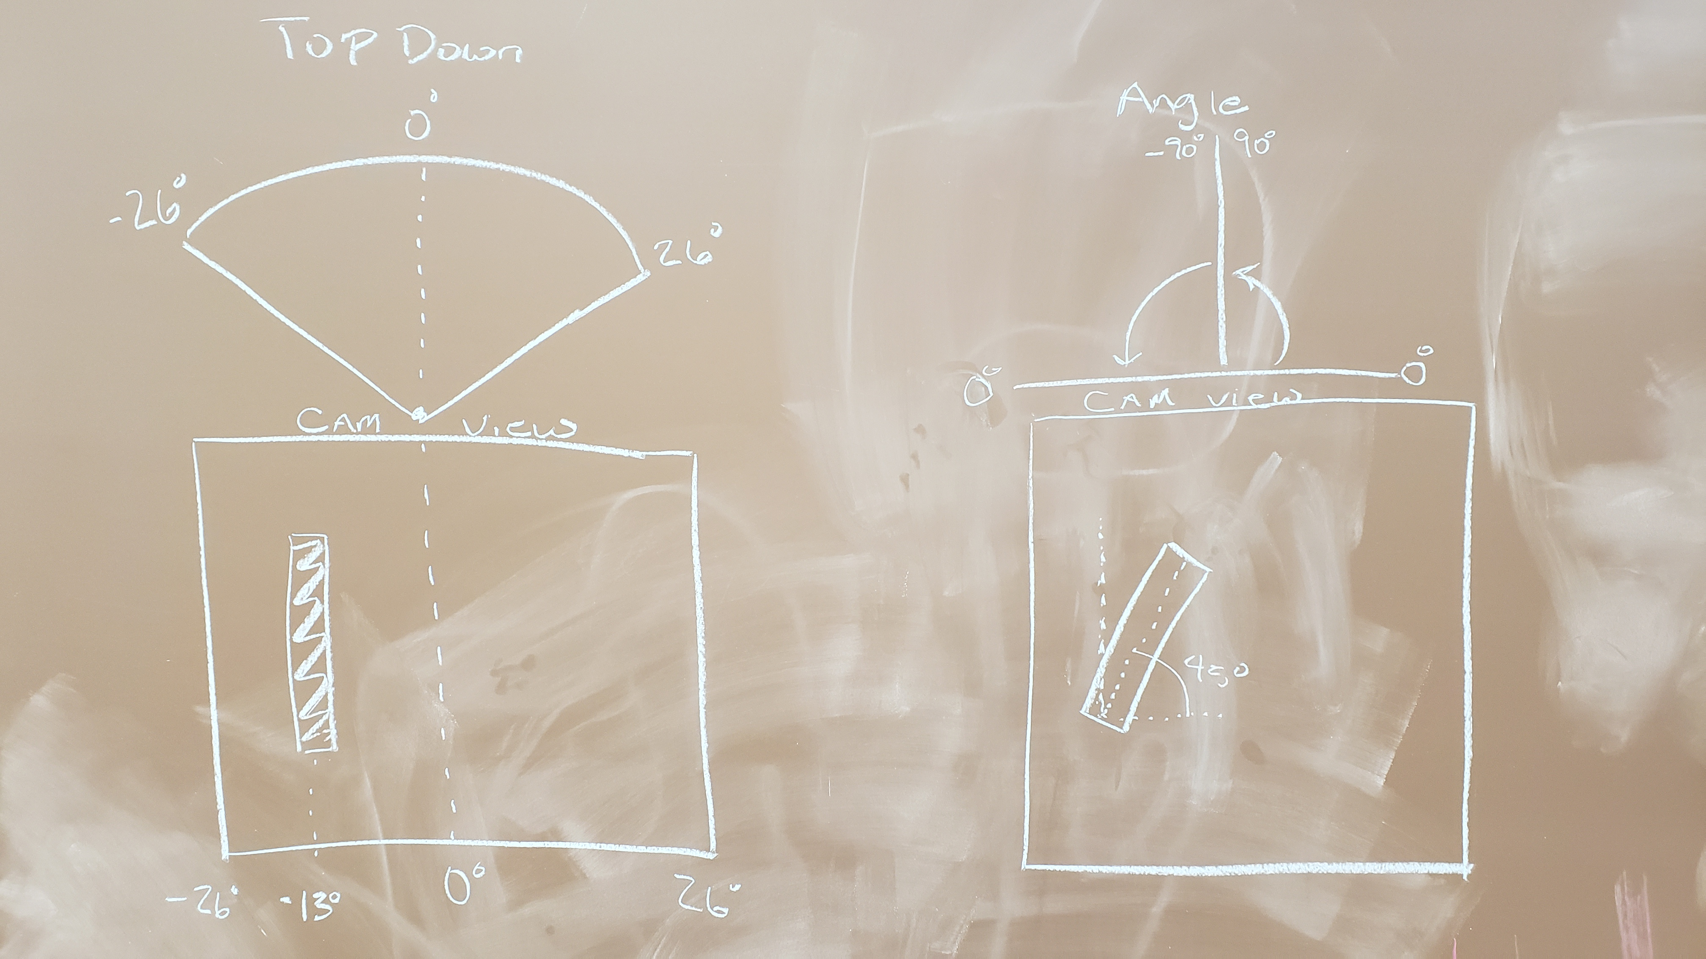
Shift Angle
Horizontal Angle

Slide 8
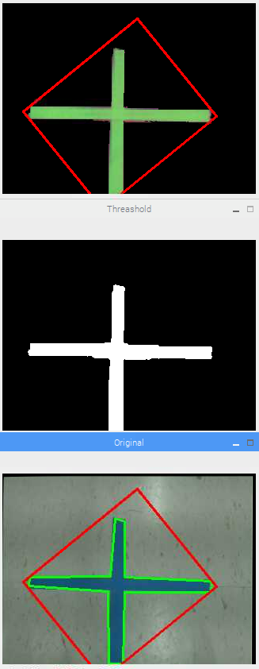
Detecting the cross
Bounding Box Area
Bounding Box Ratio
Shape Vertices
Experimental Values from tests

Slide 9
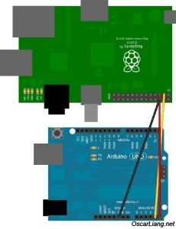
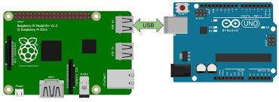
Communication
Sending data
Switch to Serial from I2C
Sending angles
I2C Communication
Serial Communication
Notes:
The system integration subsystem was designed to allow communication between the Arduino and raspberry pi. The raspberry pi would send the two angles talked about in the horizontal and shift angle slide to the arduino to allow the robot to stay on the blue tape. Originally this was done through I2C communication, but was switched to Serial communication. This was done because through I2C communication the connection was inconsistent from the wires to the pins causing an I2C input output error which caused our robot to receive the same angle rather than different ones as it would traverse the course to track the blue tape. The serial communication was consistent and robust to not cause any errors throughout the testing after switching communication types.

Slide 10
Incremental testing
Rotate Wheel
Drive in a Straight-Line and Rotate
Drive in a Straight-Line using Computer Input
Handle various Turns
Notes:
Ensuring the robot could move to its desired location required various phases. Like previously stated, we did not rely on any simulation values past the initial k value, so all our tuning was done with physical trials. We implemented our design by ensuring our robot could do various things along the way such as rotating the wheel, driving in a straight line and rotating, using computer vision input for error tracking, then ensuring it could handle turns. Our general control structure was defined in the drive in a straight line and rotate phase, then past that it was streamlining and adjusting that control scheme to ensure it could track error given inputs from the camera instead of it being hard coded. We ran many tests of setting the robot on a straight blue line, or near a blue line, then seeing if our current code could follow and stopping on the blue line of tap. Adjustments we made included making more vigorous angle error corrections and adding in cases for it to stop when it reached the front or back of the blue tape. Luckily, this code worked for the final demonstration, so we did not need to make many major adjustments. The biggest adjustment we needed to make for the final demonstration was adding in a horizontal angle in addition to the shift angle. This addition allowed our robot to handle hard turns and made the robot more capable of correcting back onto the line if it ever wandered off. We also switched our communications from I2C to serial because we were experiencing consistent communication issues. This switch eliminated the com issues ensuring the robot was able to continuously communicate with its various hardware systems.

Slide 11
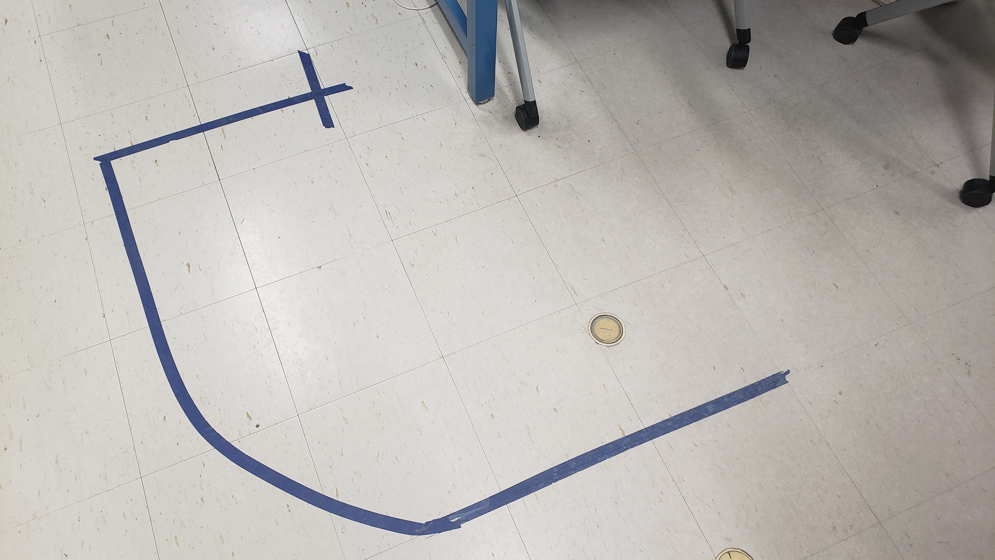
Other Tests
Built the course
Test sharp turns
Test slow turns
Test camera FOV
Notes:
To run more comprehensive tests on the robot, the team built the final course and used it as a proving ground. The first thing to check was if the robot could stay on the course through turns, this amounted to just running the robot and changing how much it used the angle correction to decide motor values. If the turn was too sharp, the robot wouldn’t make it, so the horizontal angle was used for angle error.

Slide 12
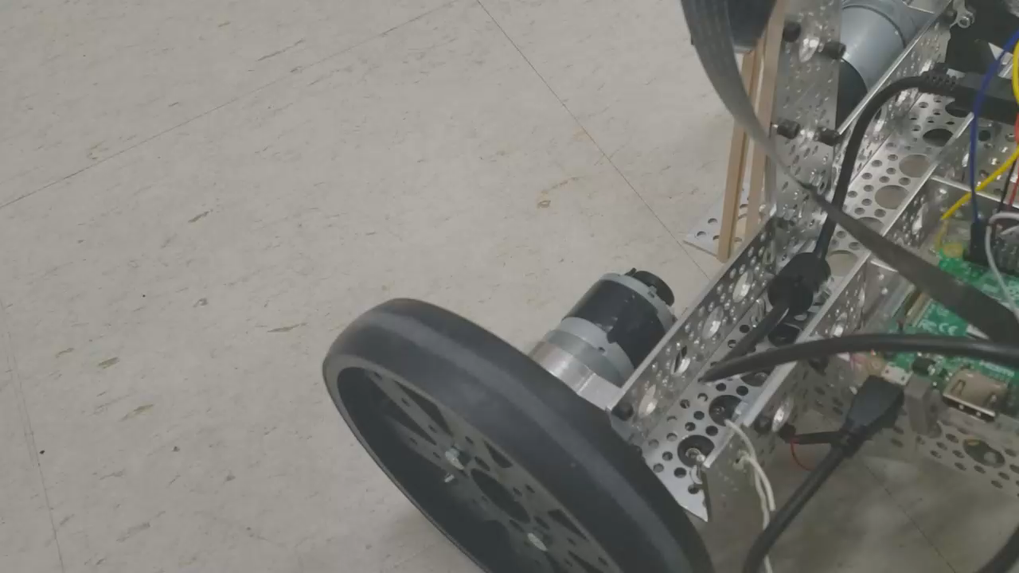

Slide 13
Final results
45 second course time
Stopped on the cross exactly
Challenges to overcome was the communication errors inconsistency
The angle correction worked correct every time
Better angle correction consistency
The angle correction would work better sometimes versus others
Notes:
The final results of the project was a course time of 45 seconds with stopping on the cross exactly. These were successes as our team completed the course in the fastest time, and some aspects that needed to be overcome that was talked about in previous slides was the communication which caused about a week of struggling to debug and fix, but other than that aspect every other subsystem worked well and functioned correctly about a week or two before the final demonstration. Something that may need to get worked on is the angle correction to follow the tape exactly under the robot. The angle correction worked correctly every time, but sometimes the robot would follow under the tape exactly the whole course and others it would have to make sharper turns to follow the tape on wide curves, which could be worked on to make it work consistently 100% of the time.

